Slide 1
Week 12: Edge Based Segmentation
Hazal Moğultay and Fatoş T. Yarman Vural

Slide 2
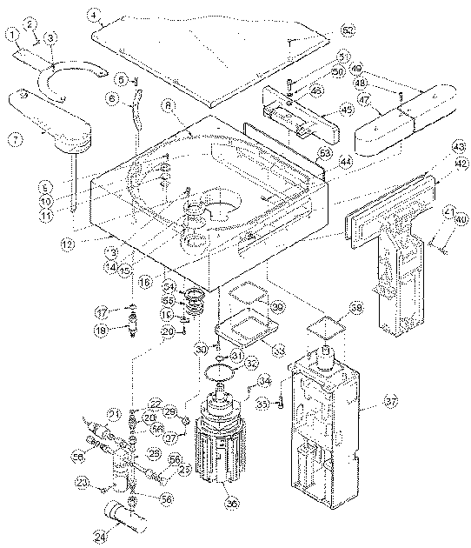
Edge Based Segmentation
In some image sets, lines, curves, and circular arcs
are more useful than regions or helpful in addition
to regions.
Lines and arcs are often used in
Object recognition
Stereo matching
Document analysis
Medical Image Analysis
Remote Sensing

Slide 3
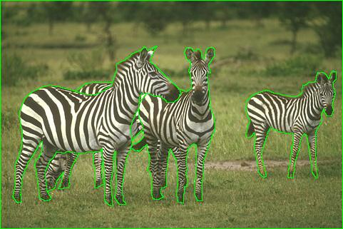
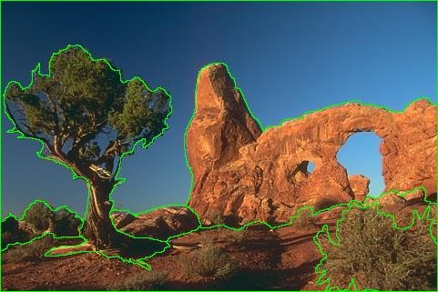
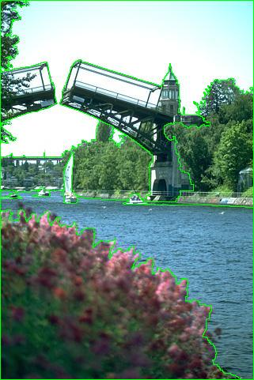
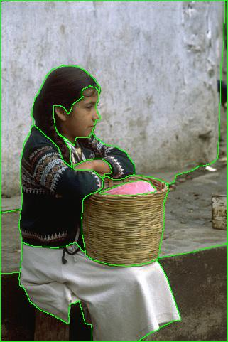
Edge Based segmentation

Slide 4
From images to objects
What defines an object?
Subjective problem, but has been well-studied.
“What is interesting and what is not” depends on the application.
There is no single solution to this problem.
Gestalt laws seek to formalize this.

Slide 5
Gestalt laws: The law of grouping the regions
Proximity: tokens that are nearby tend to be grouped.
Similarity: similar tokens tend to be grouped together.
Common fate: tokens that have coherent motion tend to be grouped together.
Common region: tokens that lie inside the same closed region tend to be grouped together.
Parallelism: parallel curves or tokens tend to be grouped together.
Closure: tokens or curves that tend to lead to closed curves tend to be grouped together.
Symmetry: curves that lead to symmetric groups are grouped together.
Continuity: tokens that lead to “continuous” curves tend to be grouped.
Familiar configuration: tokens that, when grouped, lead to a familiar object, tend to be grouped together.

Slide 6
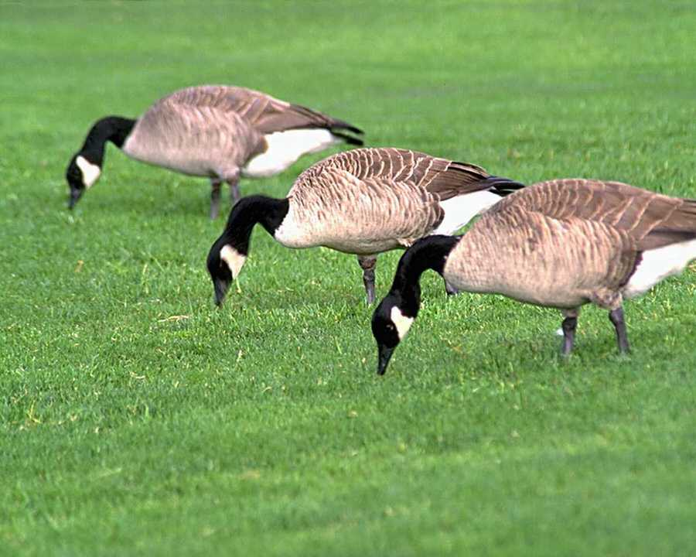
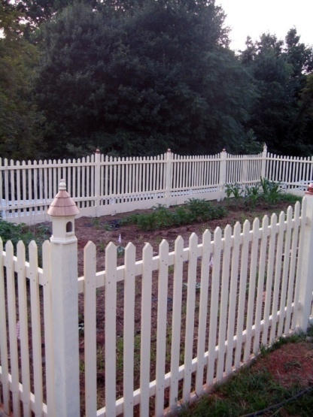
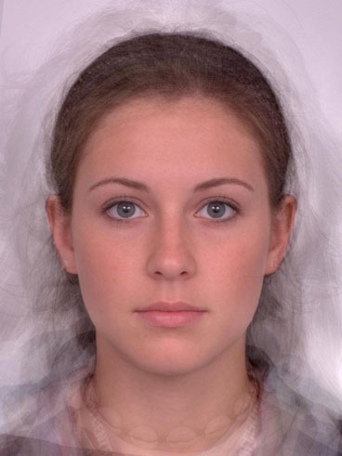
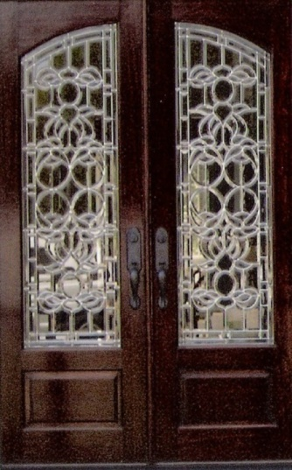
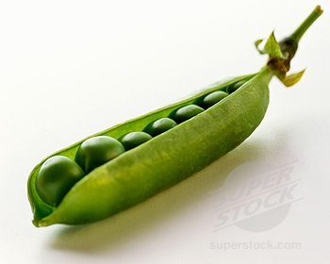
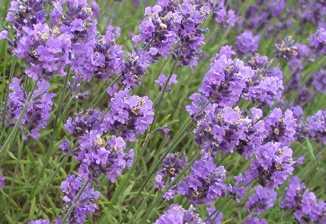
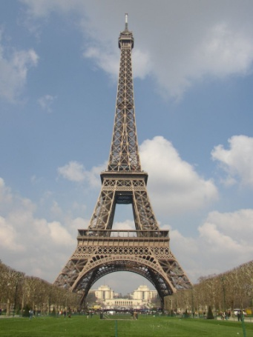
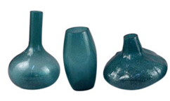
Gestalt laws
Symmetry
Similarity
Adapted from Kristen Grauman

Slide 7
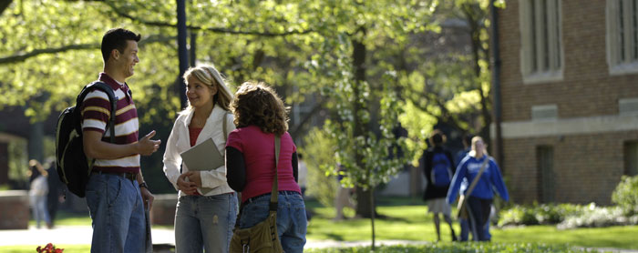
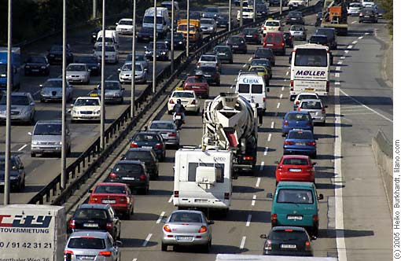
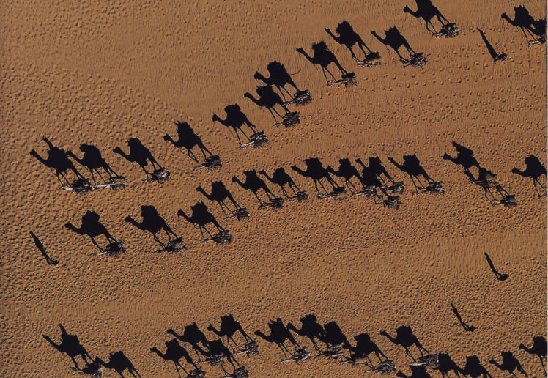

Gestalt laws
Proximity
Common fate
Adapted from Kristen Grauman

Slide 8
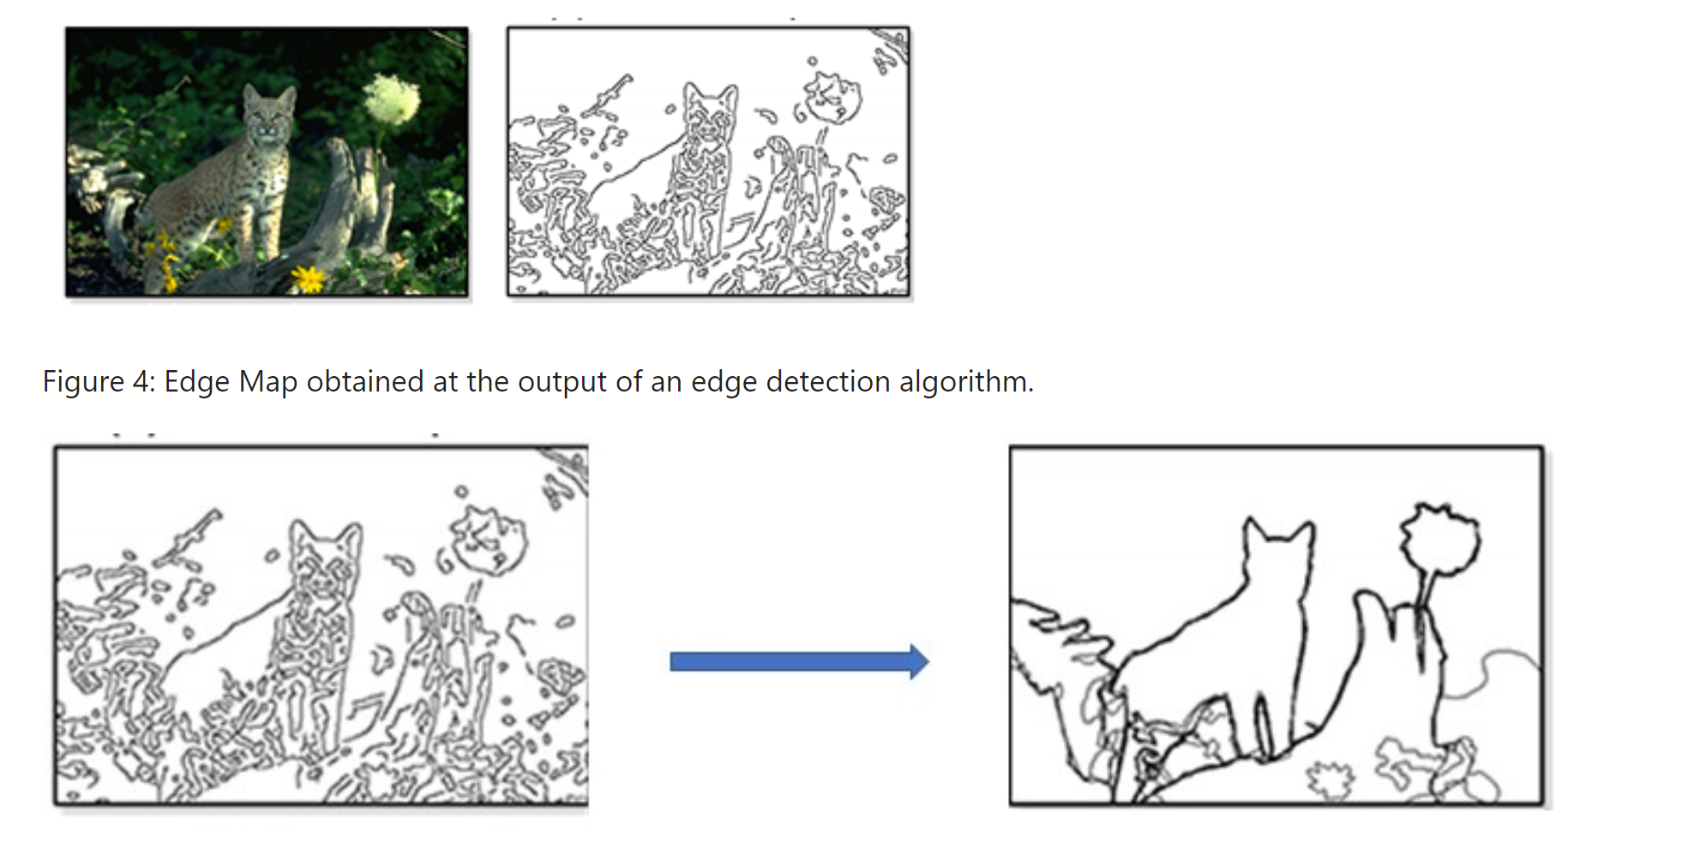
Edge Based Segmentation
Obtain the edge map at the output of an edge detection algorithm.
Extract the Boundary using the edge map.

Slide 9
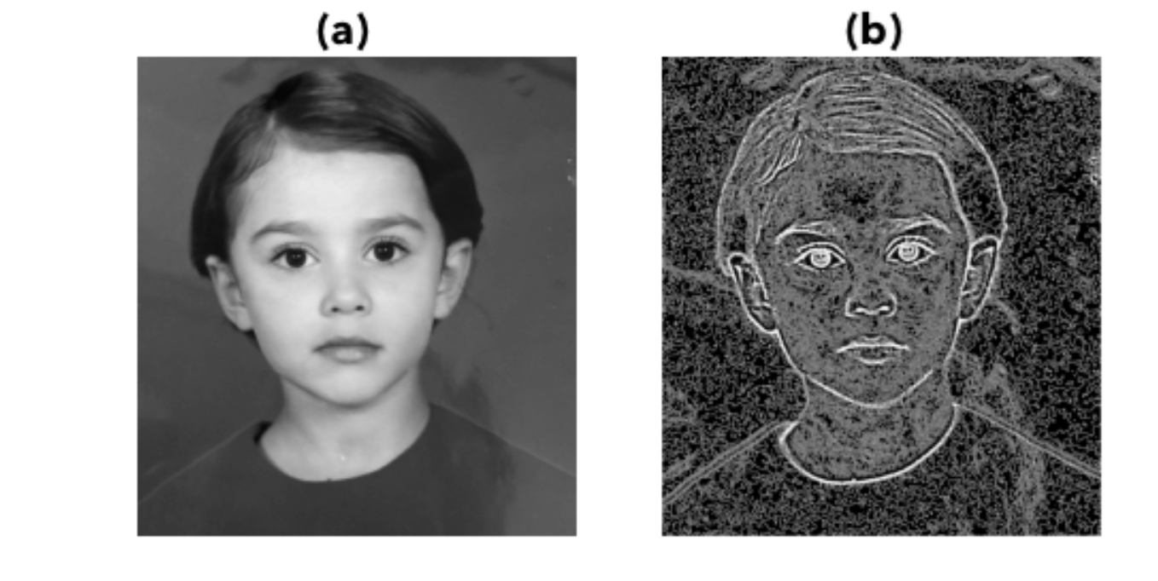
Output of Step 1: Laplacian operators

Slide 10
Marr/Hildreth edge detector
Step 1: Convolve the image with the Laplacian of Gaussian filter and find the zero crossings.
Step 2: Convolve the image by gradient filters defined in horizontal, vertical, left diagonal and right diagonal directions and keep the edge direction providing the largest magnitude.
Step 3: Keep the zero crossings obtained in Step 1, whose corresponding magnitude of the gradient above a specified threshold.

Slide 11
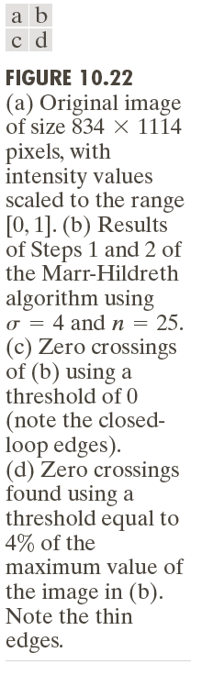
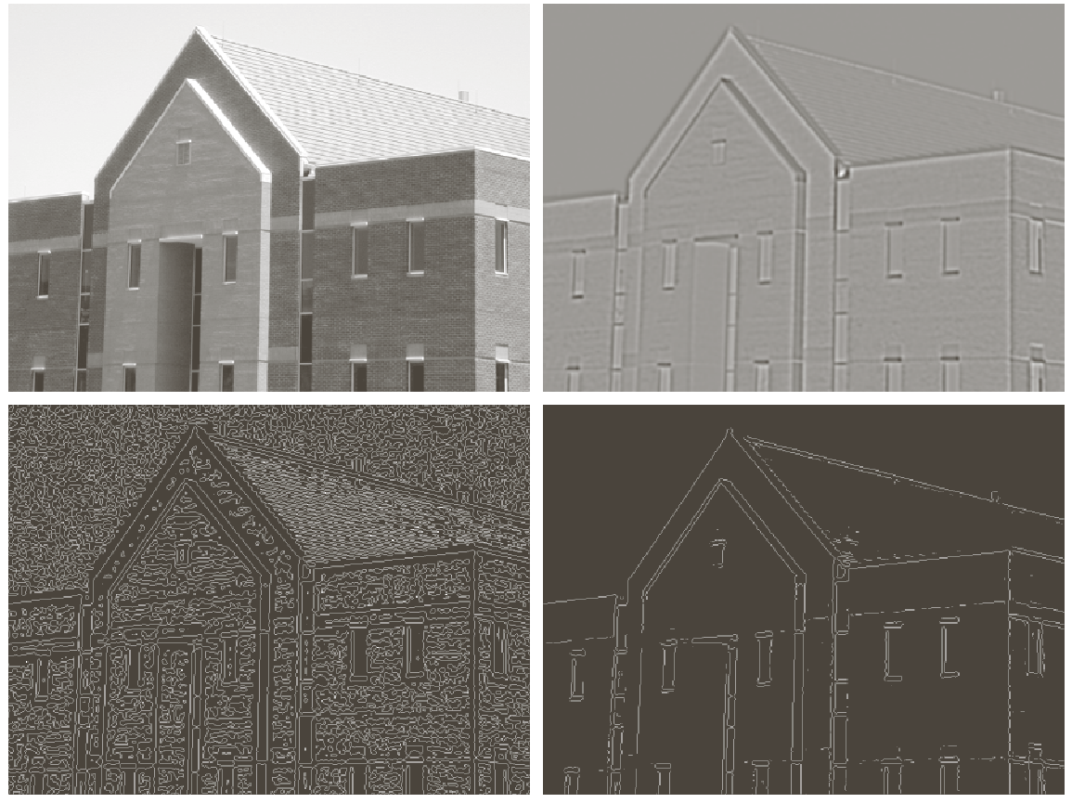
Marr/Hildreth edge detector

Slide 12
Canny edge detector (J. Canny 1986)
Smooth the image with a Gaussian filter
Compute gradient magnitude and direction at each pixel of the smoothed image.
Non-maxima suppression: Zero out any pixel response less than or equal to the two neighboring pixels on either side of it, along the direction of the gradient
Hysteresis thresholding: Track high-magnitude contours using thresholding
Keep only pixels along these contours, so weak little segments go away.

Slide 13
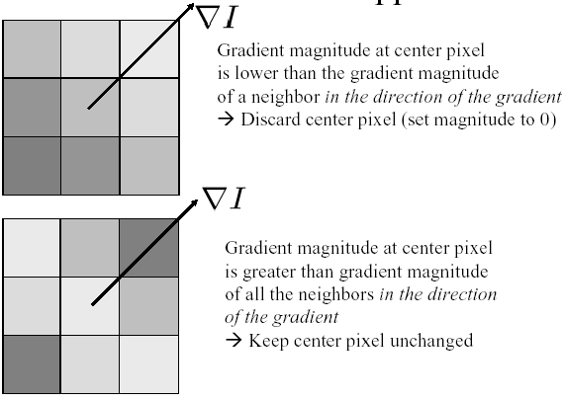
Step 3: Non-maxima suppression
Suppress an edge pixel that is not higher than the two neighboring pixels on either side of it along the direction of the gradient.
This operation can be used with any edge operator when thin boundaries are wanted.
Note: Brighter squares illustrate stronger edge response.
Adapted from Martial Hebert, CMU

Slide 14
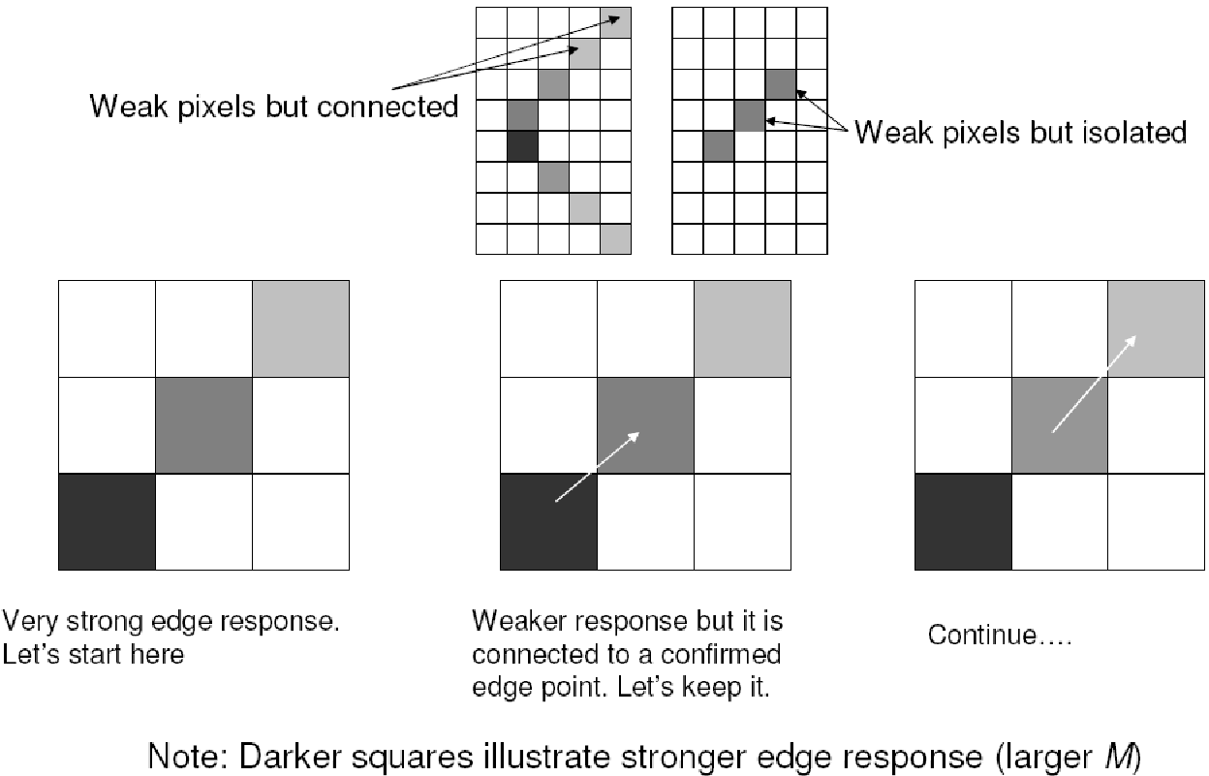

Step 4: Hysteresis thresholding
Start contour following with an edge pixel, where the gradient magnitude meets a high threshold, $Th.$
Continue contour following through pixels whose gradient magnitude meet a lower threshold, $Tl$ = 0.5 $Th.$
Remove the contour segments, shorter than a predefined length, $l$ pixels.
Adapted from Martial Hebert, CMU

Slide 15
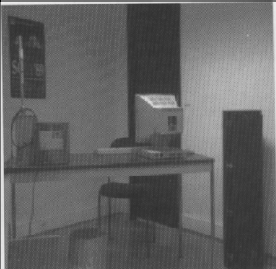
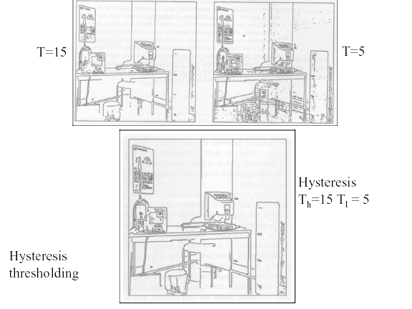
Canny edge detector
Adapted from Martial Hebert, CMU

Slide 16
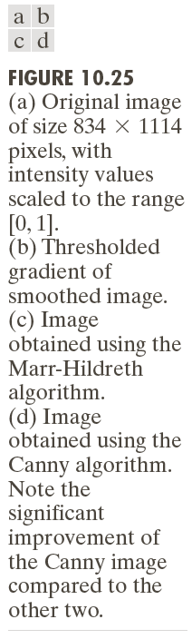
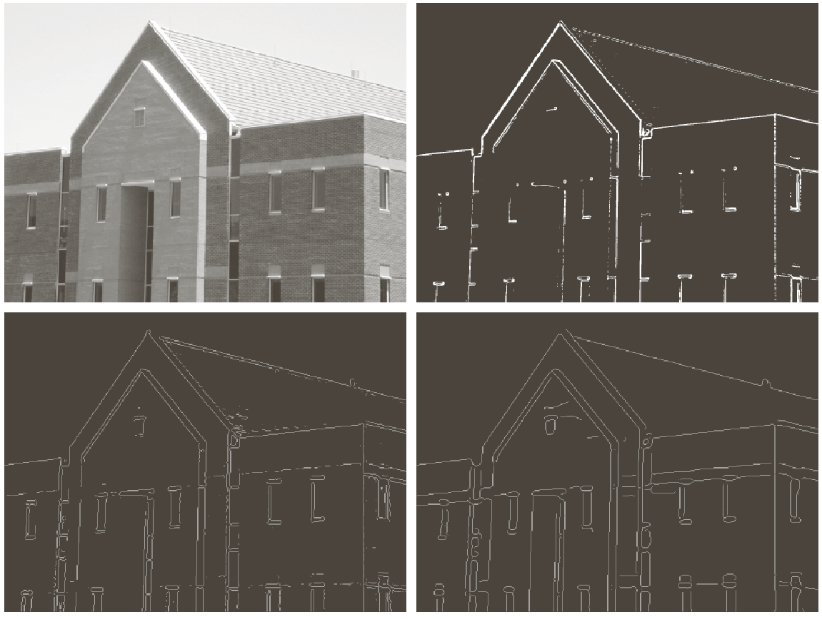
Marr-Hilderith vs. Canny

Slide 17
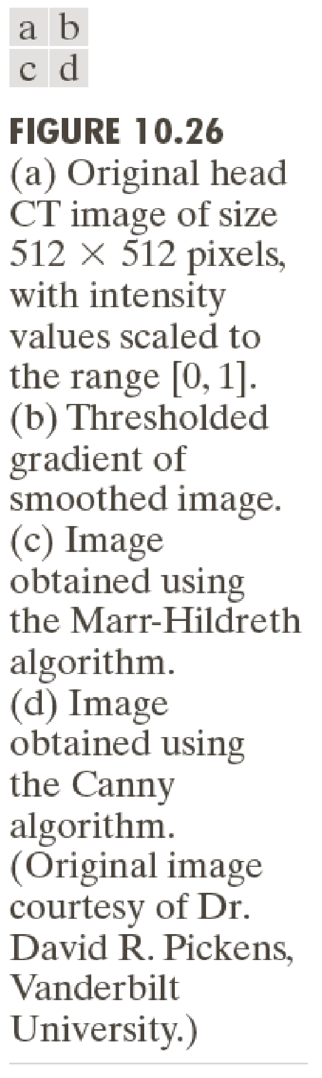
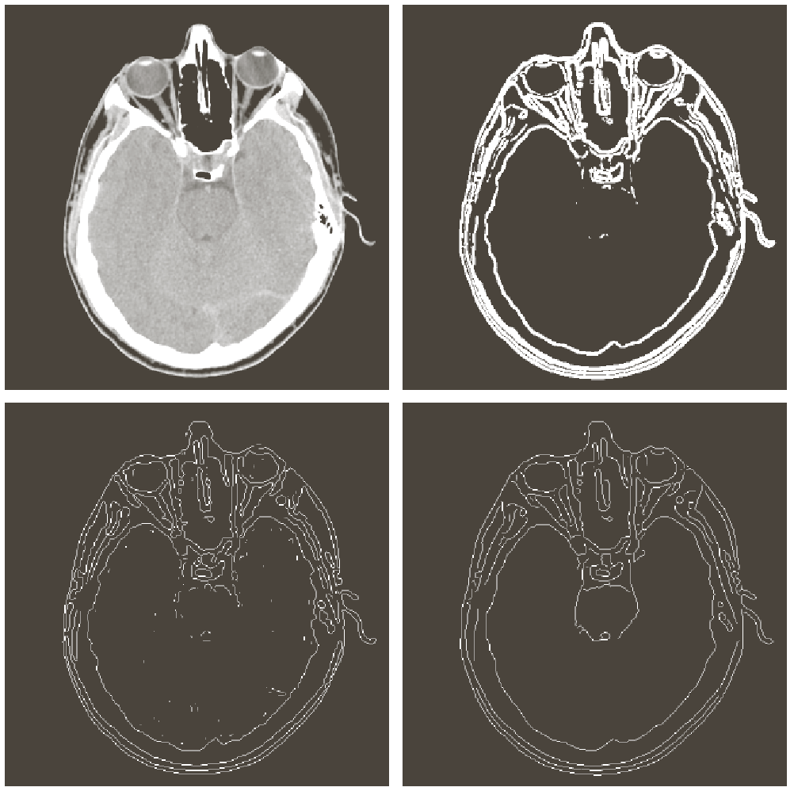
Marr-Hilderith vs. Canny

Slide 18
Canny edge detector
Canny operator gives single-pixel-wide images with good continuation between adjacent pixels.
It is the most widely used edge operator today; no one has done better since it came out in the late 80s. Many implementations are available.
It is very sensitive to its parameters, which need to be adjusted for different application domains.

Slide 19
Edge Based Segmentation
Edge Detection
Edge Linking and Boundary Extraction: Given the edge map at the output of an edge detection algorithm, find a closed boundary of a region

Slide 20

2. Edge Linking and Boundary Detection
1. Hough transform
2. Polygon approximation
3. Super slice method

Slide 21
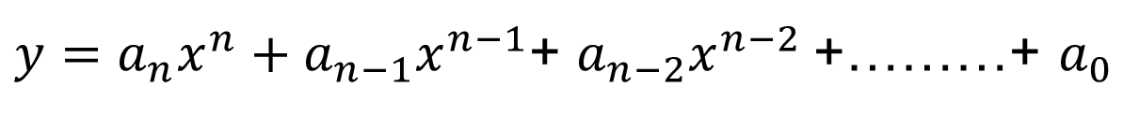
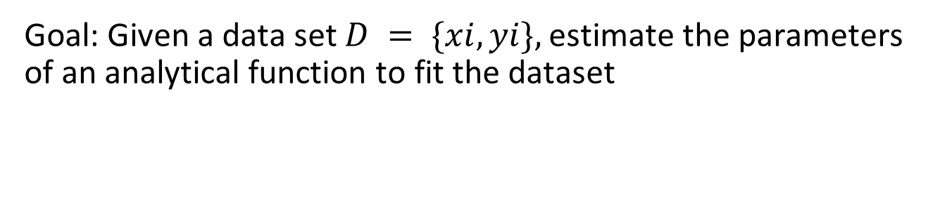
1. Hough Transform
Goal: Given a data set $D = \{xi, yi\},$estimate the parameters of an analytical function to fit the dataset
$y=a_{n}x^{n}+a_{n−1}x^{n−1}$+ $a_{n−2}x^{n−2}$+………+ $a_{0}$

Slide 22
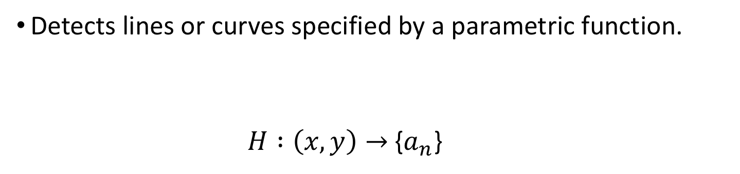
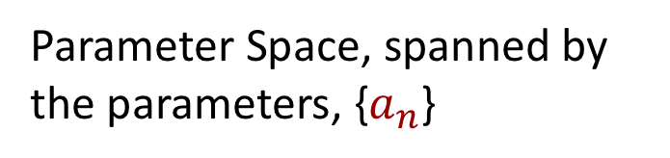
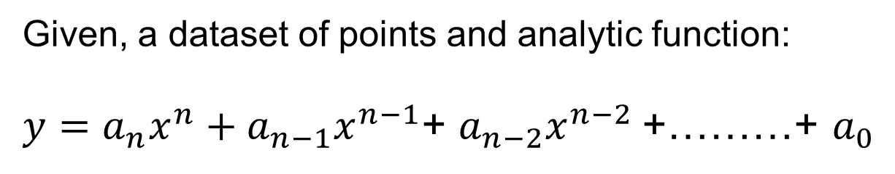
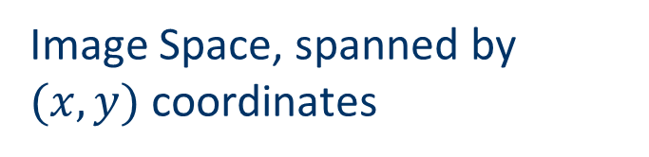
Hough Transform and Hough Space
Given, a dataset of points and analytic function:
$y=a_{n}x^{n}+a_{n−1}x^{n−1}$+ $a_{n−2}x^{n−2}$+………+ $a_{0}$
Hough transform:
Edge Map
Image Space, spanned by $(x,y)$coordinates

Slide 23

Hough Transform for Detection Line Segments
Goal: Given an edge map, find the best parameter pair (a,b) to fit a line to the edges.

Slide 24
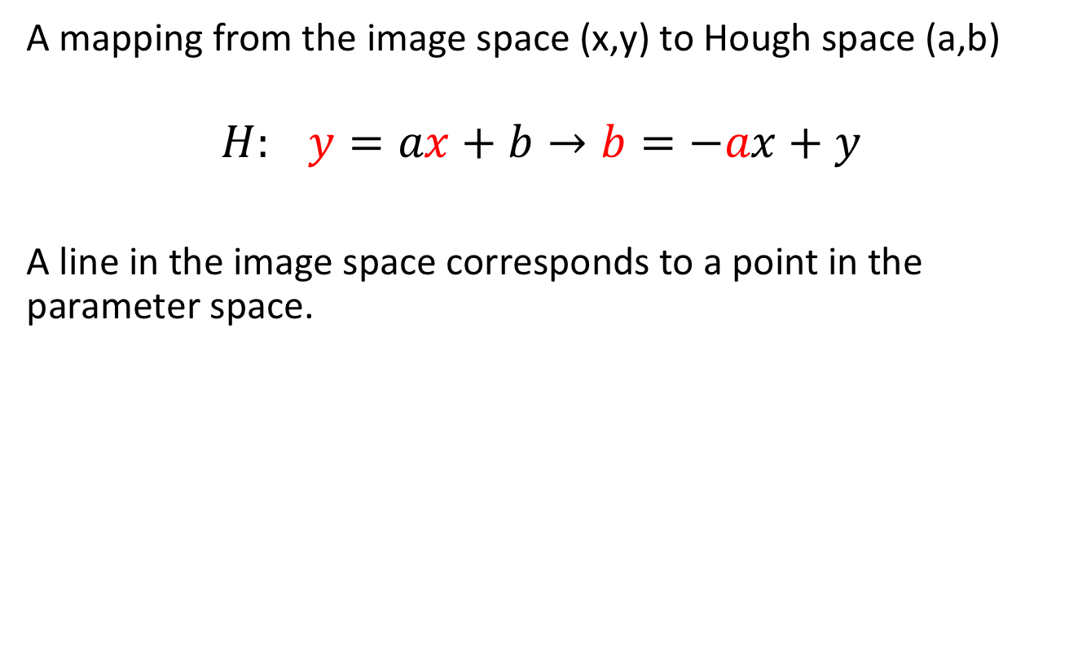
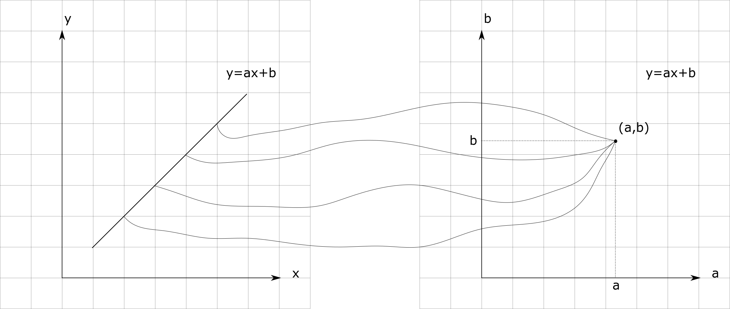
Hough Transform for Detection Line Segments
Image Space Hough Space

Slide 25
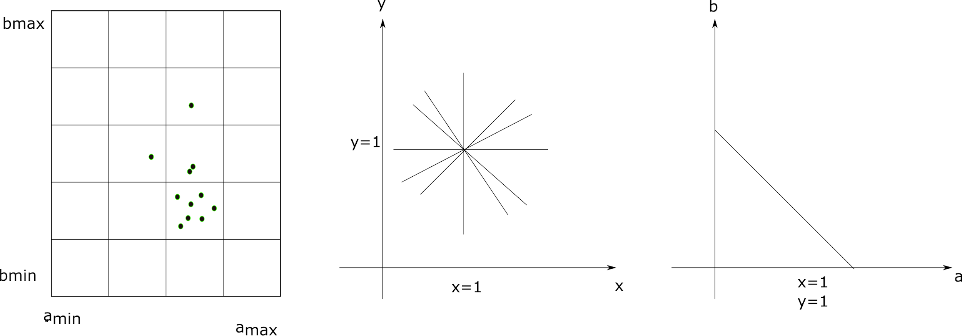

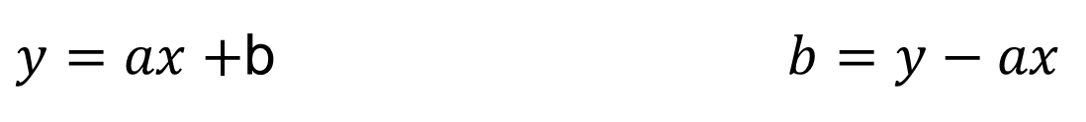
A Point in the image space corresponds to line in the parameter space.
$$b=1−a$$
$y=ax+$b $b=y−ax$

Slide 26
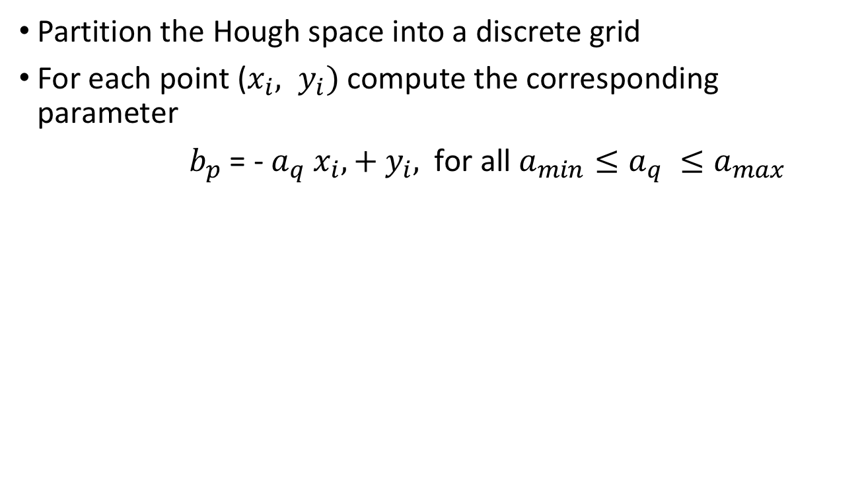
Accumulator Cells

Slide 27
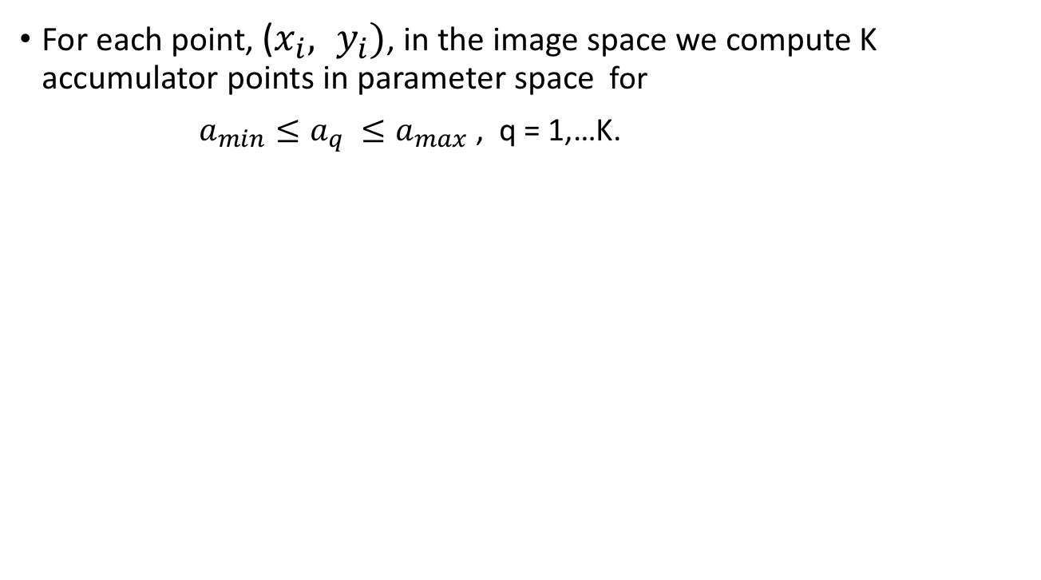
Accumulator Cells in the Hough Space

Slide 28
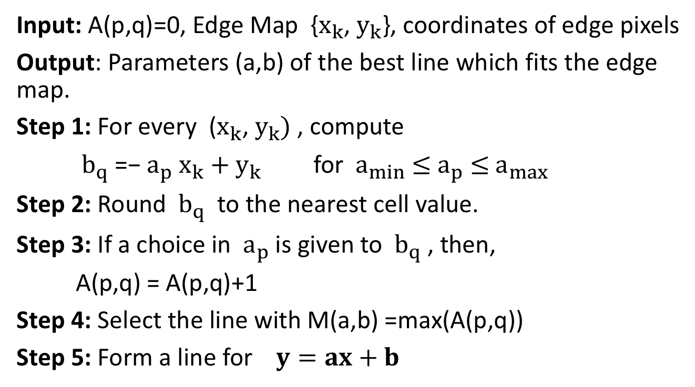
Algorithm: Line Detection with Hough Transform

Slide 29
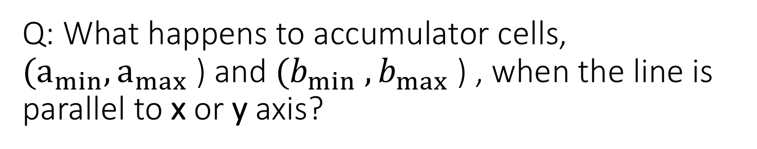
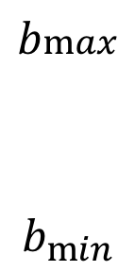

y = ax + b is not suitable (why?)

Slide 30
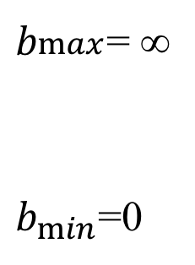

Slope, a= ∞ or intercept, b = ∞

Slide 31
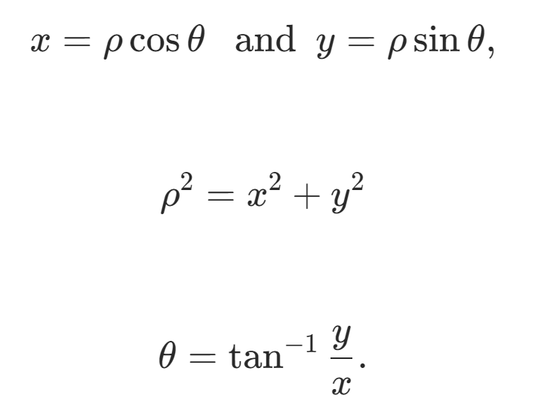
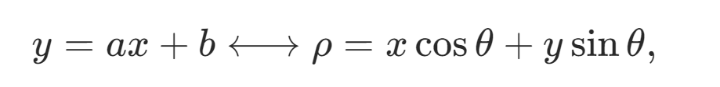
Line Equation in Polar Coordinates

Slide 32
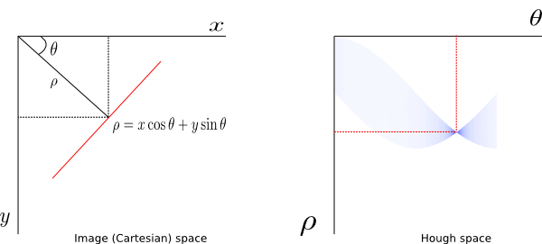
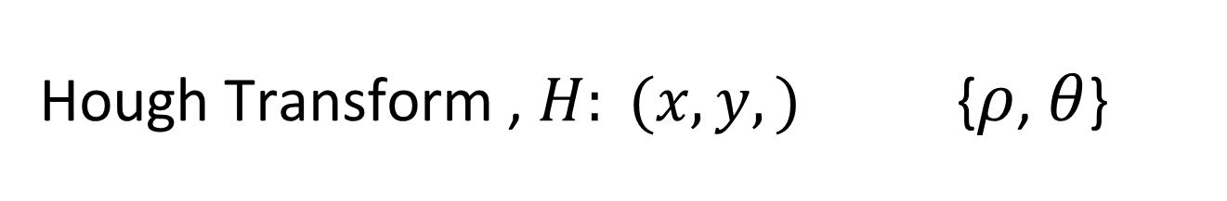

Hough Transform , $H: (x,y,)${$ρ$, $θ$}
$$ρ=x Cos θ+y Sin θ$$

Slide 33
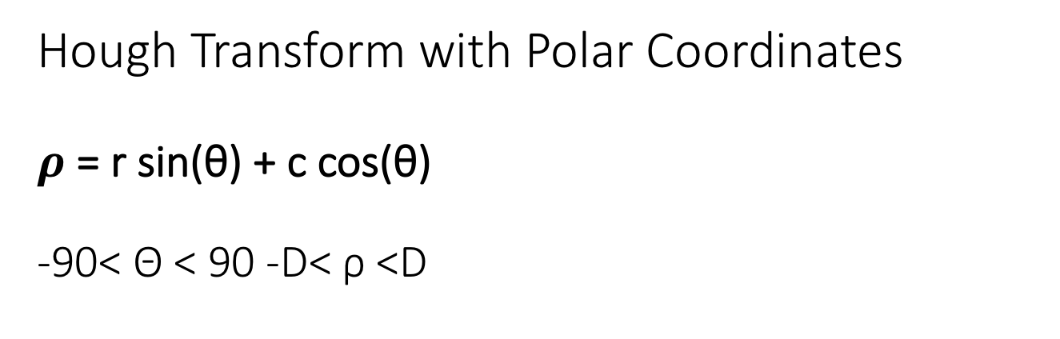


$$ρ=x Cos θ+y Sin θ$$

Slide 34

Hough transform: Line segments

Slide 35


Hough transform: line segments

Slide 36
Does Hough transform for line fitting output a closed boundary?

Slide 37

How to Extract Closed Boundary

Slide 38
Hough Transform
Hough transform detects high order polynomials specified by a parametric function.
If the parameters are a₁, a₂, … a_{n}, then the Hough transform uses an n-dimensional accumulator array in which it accumulates votes for the correct parameters of the lines or curves found on the image.
y = ax + b
a
image
b
accumulator
Adapted from Linda Shapiro, U of Washington

Slide 39
Hough Transform for circle fitting

Slide 40



Hough transform: Circles
Goal Find the parameter set of a cisrcle which fits the edge map best.
($x−x_{0})2+(y−y_{0}$ ) $2$ = d $2$
d
Adapted from Linda Shapiro, U of Washington

Slide 41


Suppose the radius $d$ is given: A point in image space is mapped to a circle in Hough space

Slide 42

A Circle point in image space maps to what in Hough space?

Slide 43
H: Circle points Cones

Slide 44
Generalized Hough Transform for nonparametric shapes
Given a set of edge pixels, how to find a nonparametric boundary?

Slide 45

Generalized Hough Transform
Model Shape NOT described by equation

Slide 46
Generalized Hough Transform
Model Shape NOT described by equation

Slide 47
Generalized Hough Transform
Find Object Center given edges
Create Accumulator Array
Initialize:
For each edge point
For each entry in table, compute:
Increment Accumulator:
Find Local Maxima in

Slide 48


Slide 49
2. Border Detection with Polygon Approximation

Slide 50
Border Detection with Polygon Approximation

Slide 51

Polygon Approximation to a Single Object

Slide 52

3. Super slice method
Combine region based and edge based methods.

Slide 53


Super Slice Method
1. Find the edge map
2. Find a region based segmentation map
3. Merge the two map by maximizing the edge and boundary overlaps.

Slide 54
Quiz #14
Fit a Gaussian density to the color histogram of the following image patch, using Mean Shift method.
Find the mean.
Find the variance.
Initialize with mean, m(0) = 1
0 | 1 | 2 | 2
1 | 2 | 2 | 2
2 | 2 | 2 | 3
2 | 2 | 3 | 0

